Slide 1
PLUG MTAANI BUSINESS IDEA COMPETITION
- VIJANA2INVEST
Connecting Ideas to Opportunities

Slide 2
Plug Mtaani
Plug Mtaani-Vijana2Invest is a national youth entrepreneurship strategy focusing on unlocking the potential of entrepreneurship and investment amongst the youth.
The program intervention focuses on; capacity building; training, mentorship, financial literacy, soft skills development, seed capital, networking and linkages

Slide 3
PLUG MTAANI OBJECTIVES
The specific objectives of the programme per cycle will be
To motivate and stimulate participation of Kenyan youth in the economic activities right from their local areas.
To develop the productive capacity of Kenyan youths through practical skills training programme (ILO-SIYB) covering entrepreneurship development and soft skill.
To build an elaborate capacity building and linkages system that will enhance sustainability, market penetration and continuous growth
To enhance a saving and investment culture amongst the youth.
To create impactful and competitively sustainable businesses that have direct and indirect impact to the larger economy.
To create a platform for foreign and domestic investors to identify innovation businesses by the youth to invest in and collaborate with.

Slide 4
WHY YOUTH EMPOWERMENT
Youth Vulnerability:
Political Exploitation
Predatory lending,
Crime, drugs, diseases
Negative Attitude; entrepreneurship, savings and investment
Youth Population
25 Million
Unemployed/Under-employed youth - 61%: 15,250,000 – Nationally
: 275,798 per county
Potential:
Quick to grab opportunities
Energetic & available for training
(85% Literacy rate)

Slide 5
ACKNOWLEDGING THE ONGOING GOVERNMENT INTERVENTIONS
HUSTLER FUND
YOUTH FUND
UWEZO FUND
KYEOP

Slide 6
THE MISSING LINK
FUNDING GAPS:
Lack of Intensive Follow-up after funding
Lack of Continuous Monitoring and Evaluation
Current loan status: 60% default rate of Government loans to youth and a 15% Portfolio at Risk (PAR) for Commercial banks
TRAINING AND CAPACITY BUILDING GAPS:
Lack of quality and proven Curriculum
Lack of certified adult trainers by recognized institutions
Poor Training methodologies with low or no impact

Slide 7
OUR PROGRAMME INTERVENTION OVERVIEW
Creating a saving and investment culture
INVESTMENT
Linking youth to financing opportunities, grants and investors
FINANCIAL LINKAGES
Intense Follow-up and M & E
Training How to Develop a Bankable Business Plan
BUSINESS PLANNIN
Training How to generate feasible and innovative business ideas
BUSINESS IDEA GENERATION

Slide 8
PLUG MTAANI_VIJANA2INVEST INTERVENTION
STEP 3: NATIONAL
NATIONAL BOOT CAMP
3 Winners per county
Pitching & Judging is done physically before judges and potential investors
TV Show recorded
Public voting is opened
STEP 1: COUNTY LEVEL
TRAINING AND CAPACITY BUILDING
Train approximately 200 youths per county
2-5 days of training on ILO-SIYB (Idea generation and Business Plan creation)
Training on pitching soft skills
STEP 4:
NATIONAL AWARDS CEREMONY;
Gala awards for finals
Live show on a national TV
Top Award - 10Million
Six months mentorship of Winners
STEP 2: COUNTY LEVEL
BUSINESS COMPETITION
Youths Pitch their businessi deas
Judges select top 3 and 5 sector categories
Awarding is done at the County

Slide 9
POST CAPACITY BUILDING AND AWARDS BENEFITS;
Market and Investment linkages –
Foreign Direct Investment /Domestic Direct Investment
Incubation, apprenticeship, and ILO Mentorship programme,
Technology
-Adoption of Technology, E-Citizen services, support services,
Access to Finances;
Grants, Government and Bank Loans

Slide 10
PLUG MTAANI WORKPLAN
Timelines
JUNE
JULY
AUGUST
SEPTEMBER
Idea Selection
Program Launch
Capacity Building
County Capacity Building, Idea Competition & Awards
Planning
Stakeholder
Engagement
Start of Development
OCTOBER
NOVEMBER
DECEMBER
DECEMBER – ONWARDS
Boot Camp,
Public voting, Media shows
Live TV shows & National Awarding
ILO Mentorship
Plug Mtaani TV shows Telling stories of the Winners and others
County Competition & Awards
End of Development
Launch

Slide 11
About ILO-SIYB
The Start & Improve Your Business (SIYB) programme is a business training programme owned by the International Labor Organization -ILO with a focus on starting and improving small businesses as a strategy for creating more and better employment in developing economies and economies in transition.
It is implemented in 140 countries and translated into 40 languages

Slide 12
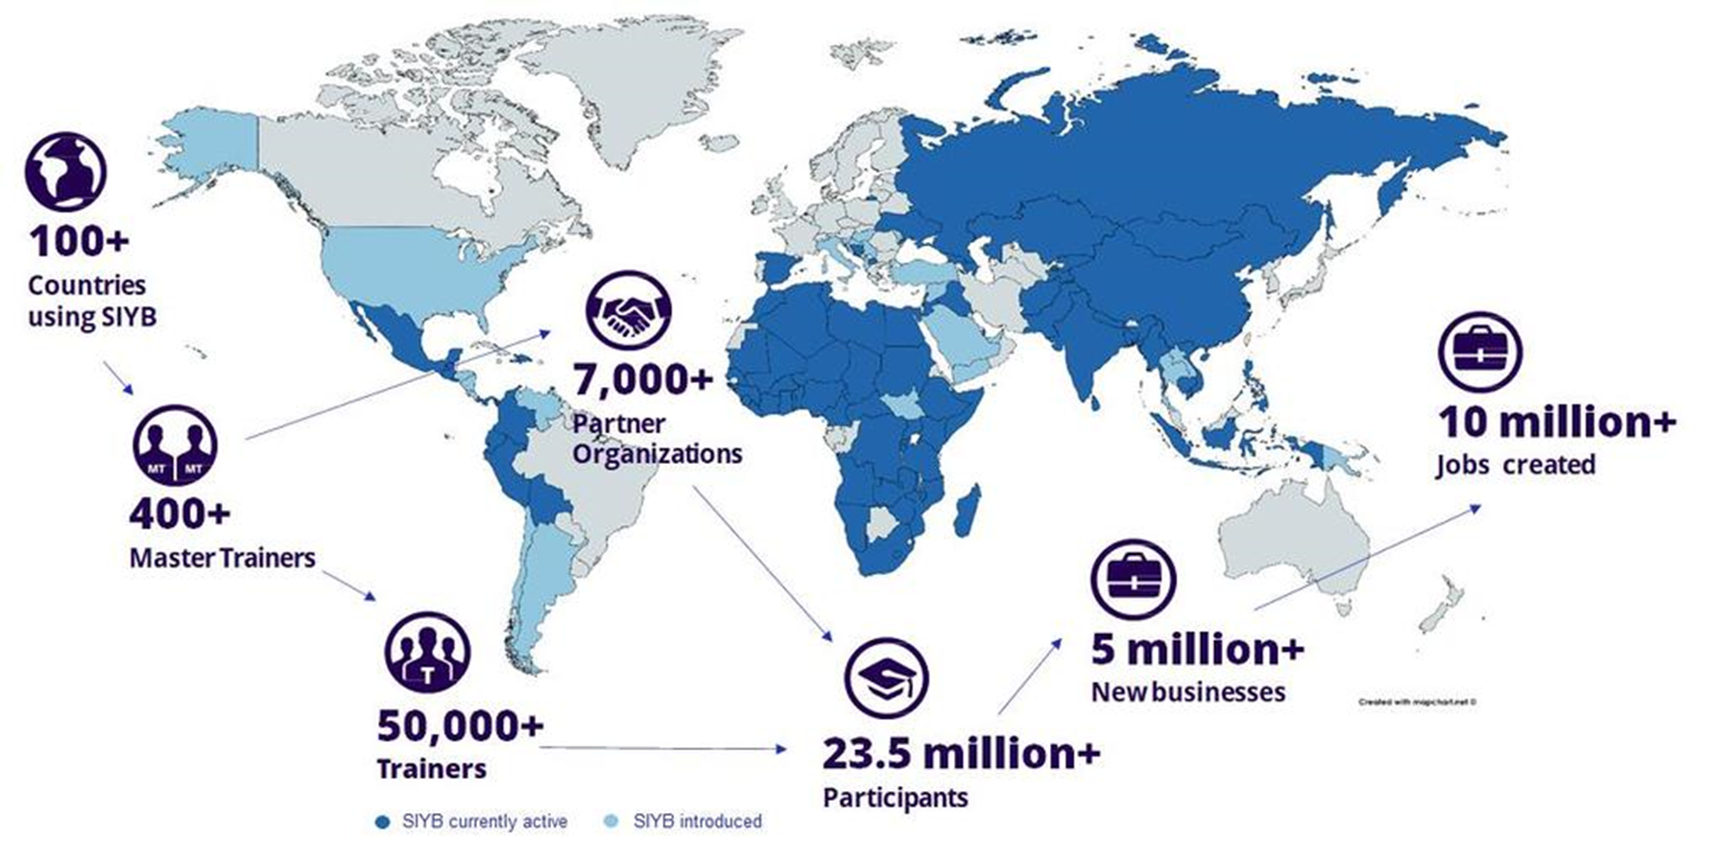

Slide 13
THE SIYB JOURNEY
2003, Expand Your Business was developed and introduced in Sri Lanka and Southern Africa
Developed in the 1970s by the Swedish Employers’ Federation as “Look after your firm”
1977 - Adapted by ILO to the needs of small-scale entrepreneurs in developing countries and renamed to “Improve your business-IYB”
In 1999 “SIYB training” became the “SIYB Programme”
1998, “Generate Your Business Idea” was developed in Southern and Eastern Africa
In the early 1990s the “Start Your Business” training package was developed in Fiji to complement the IYB training package.

Slide 14
THE ILO-SIYB TRAINING PROGRAMME
EYB - EXPAND YOUR BUSINESS
SYB -START YOUR BUSINESS
How to develop a business Expansion plan
How to write a Bankable business plan
GYBI-GENERATE YOUR BUSINESS IDEA
IYB-IMPROVE YOUR BUSINESS
How to generate a feasible business idea
How to set up a basic business management systems
THE SIYB BUSINESS GAME

Slide 15
Reason to Choose SIYB Programme
Intensive follow-up after training
Quality training with proven impact
High Trainee impact
Well-organized M&E system
Modular set-up of the course
Material-based training
Short duration of training

Slide 16
Thank You
GEOFFREY KILONZO
ILO-SIYB MASTER TRAINER
Visit Our Website
www.icstkenya.com

